Slide 1


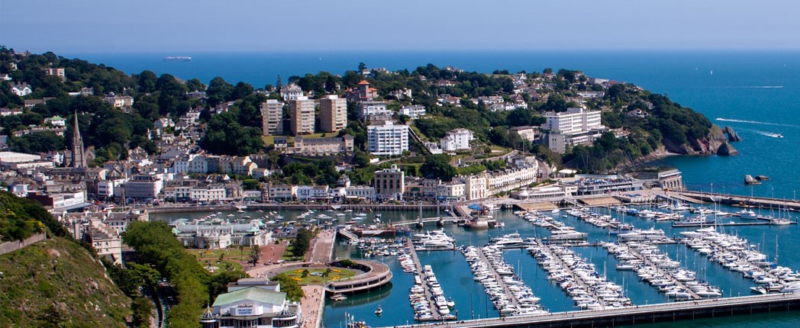

Welcome to your
Worlds 2026 preview
ROYAL TORBAY YACHT CLUB

Slide 2
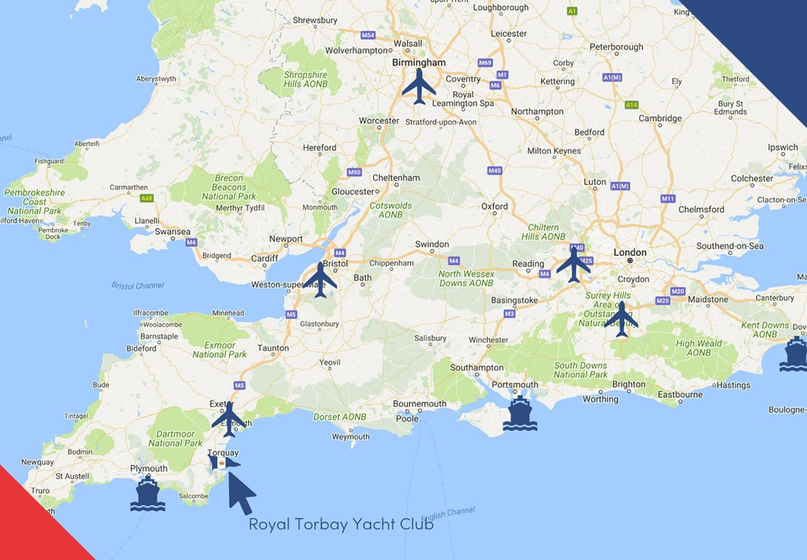

GETTING TO TORQUAY
Excellent road & rail connections
Times by road to RTYC
Airports
Exeter 40 mins
Bristol 1½ hrs
Birmingham 3hrs
Heathrow 4hrs
Gatwick 4¼ hrs
Ferry Ports
Plymouth 1hr
Portsmouth 3hrs
Dover 4¾ hrs
Fishguard 4½ hrs
Holyhead 6hrs

Slide 3
PROVISIONAL PROGRAMME OF EVENTS
UK Open & National Championships
Monday 20th July | Arrival, Inspection and Registration – Worlds and Nationals
Tuesday 21st July | Arrival, Inspection and Registration - Worlds and Nationals Commodore’s Welcome
Wednesday 22nd July | Final Inspection and Competitors Briefing Two Races
Thursday 23rd July | Three Races
Friday 24th July | Three Races Nationals Prizegiving and Dinner
World Championship
Saturday 25th July | Worlds only Inspection Registration and Competitors Briefing Opening Ceremony
Sunday 26th July | Late Inspection and Registration Two Races
Monday 27th July | Two Races
Tuesday 28th July | Two Races
Wednesday 29th July | LAY DAY (subject to change)
Thursday 30th July | Two Races
Friday 31st July | Two Races
 | Prizegiiving and Gala Dinner
Jam packed social calendar including Fireball legends evening and two formal dinners

Slide 4
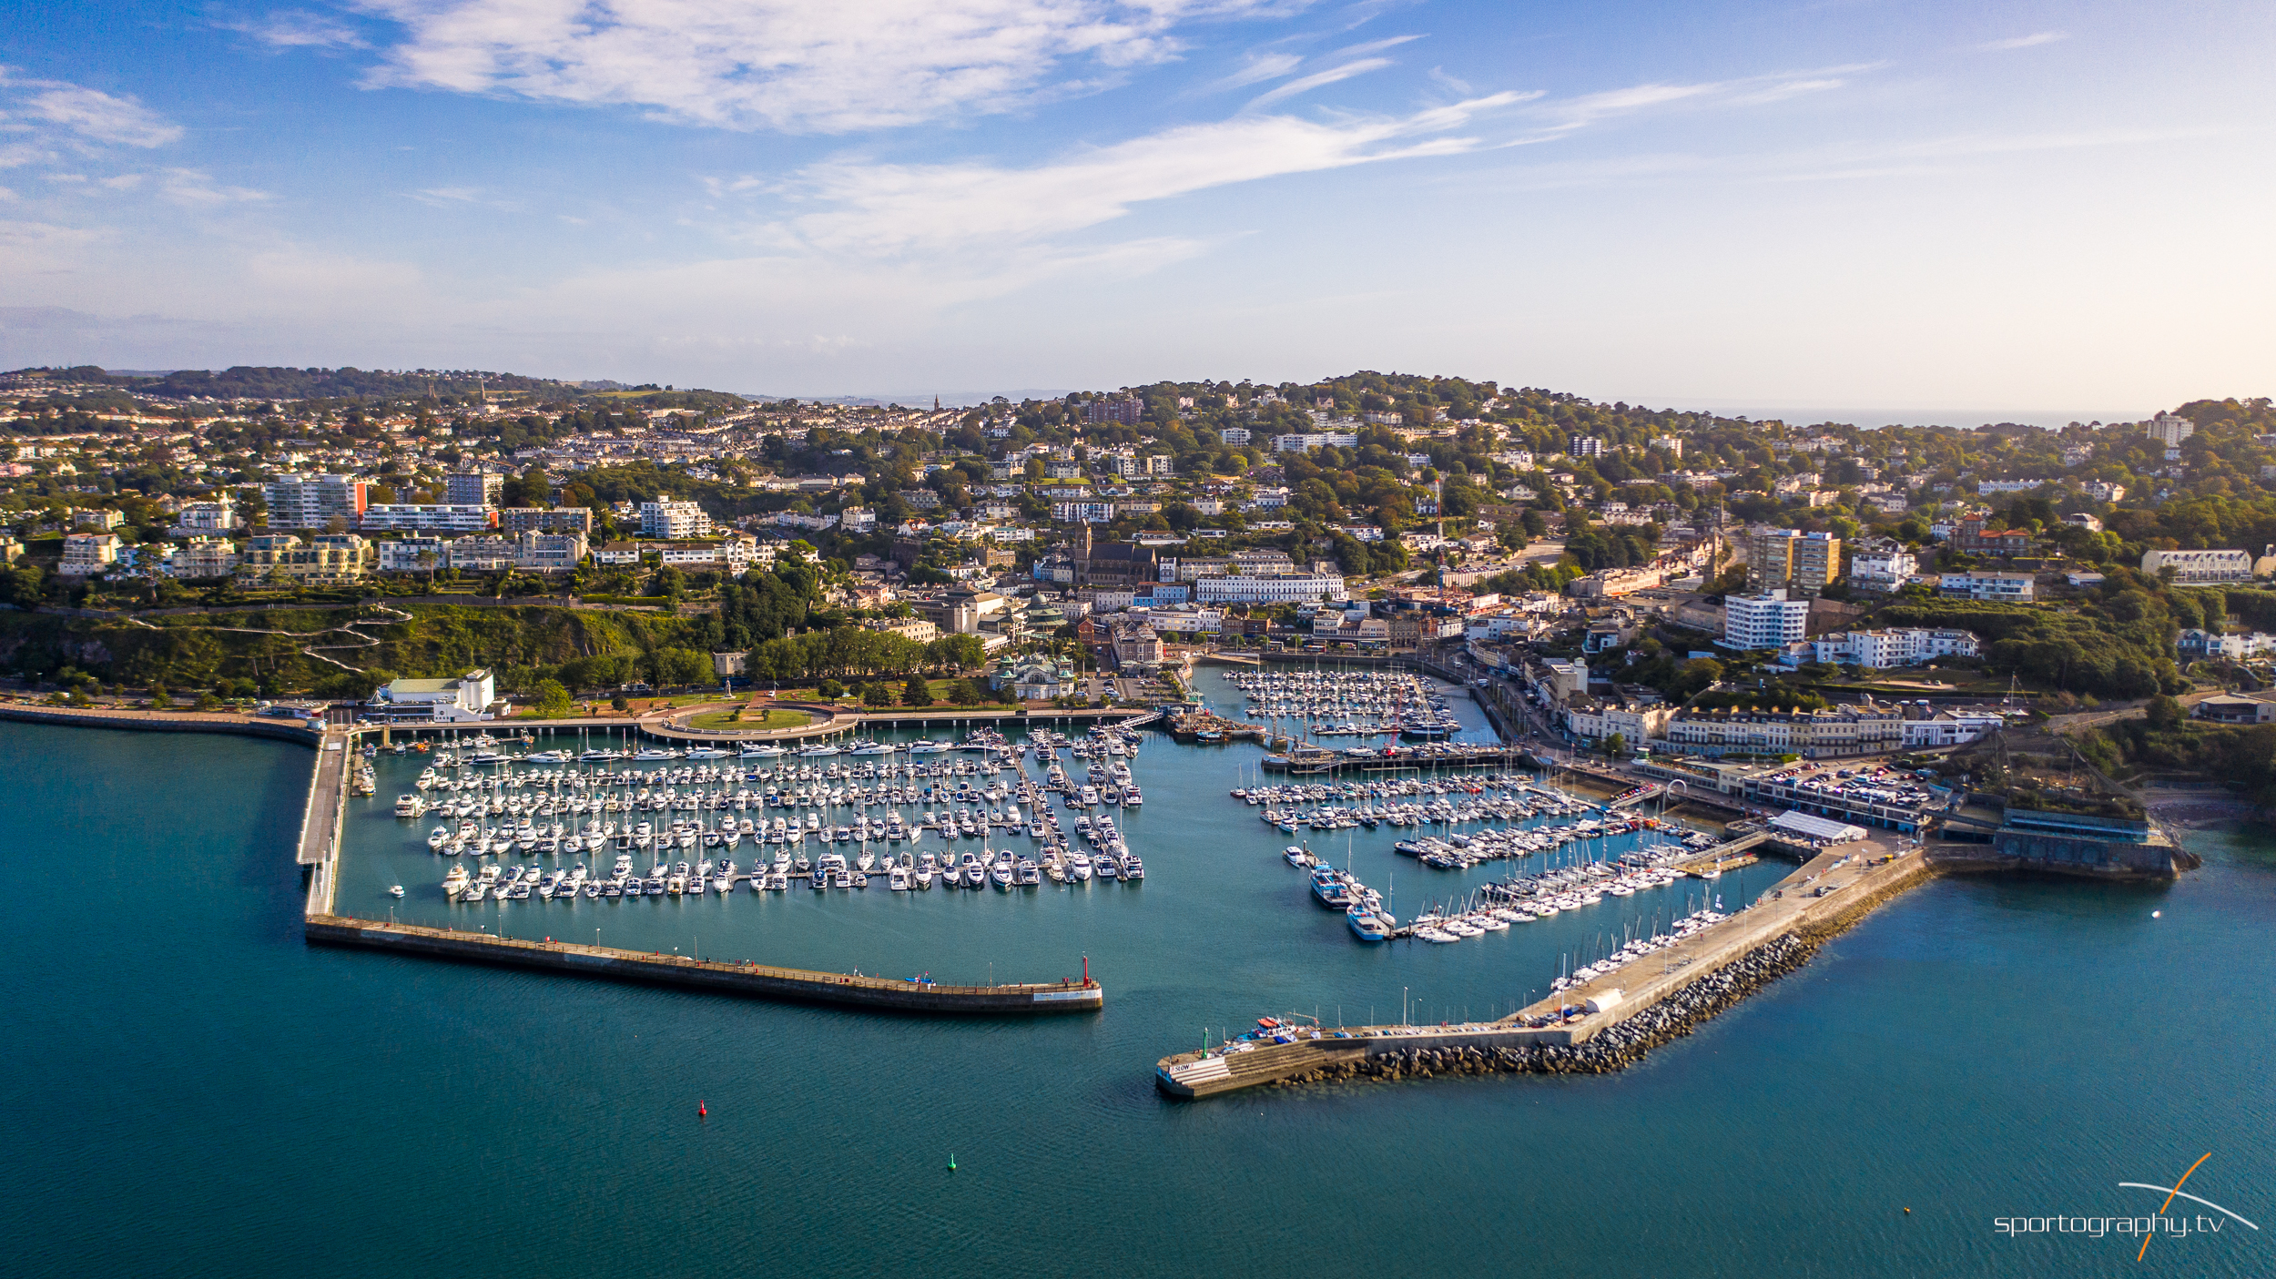
Town
Club
Car Parking
Camper
Vans
(5 mins cycle to club)
Slip
Dinghy Park

Slide 5
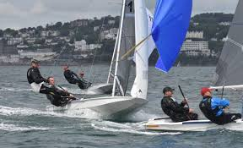
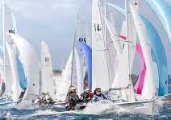
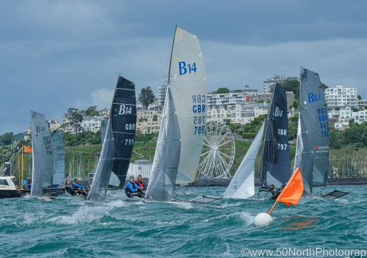
Royal Torbay Yacht Club Experience
Hosted numerous World, European and National Championships:
  29er
  420
  Cadets
  Fireball
  International Moth
  J70
  Optimists……etc
PRO Stuart Childerley
  Laser Youth World Champion
  UK Finn rep 1988 & 1992 Olympics
  2x Etchells World Champ
  Race Team Tokyo & Paris Olympics

Slide 6
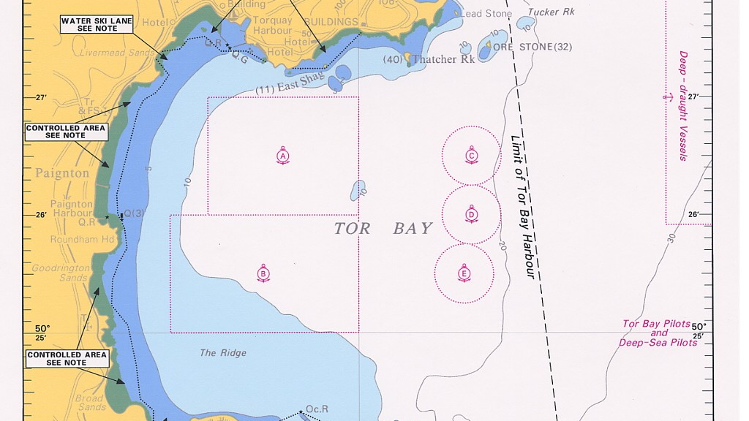
RACE AREA WITH NO MAJOR OBSTRUCTIONS AND LITTLE TIDAL IMPACT
Prevailing winds for July:
15mph SW

Slide 7
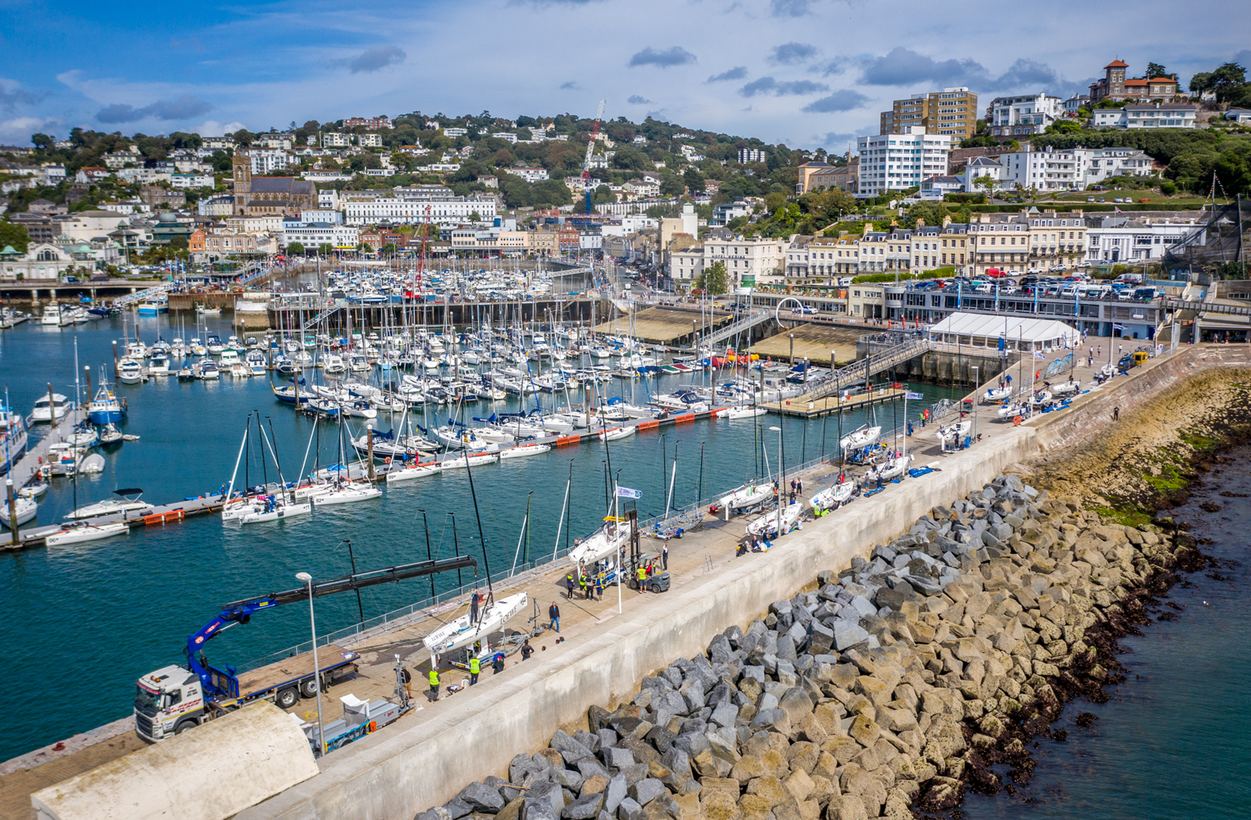
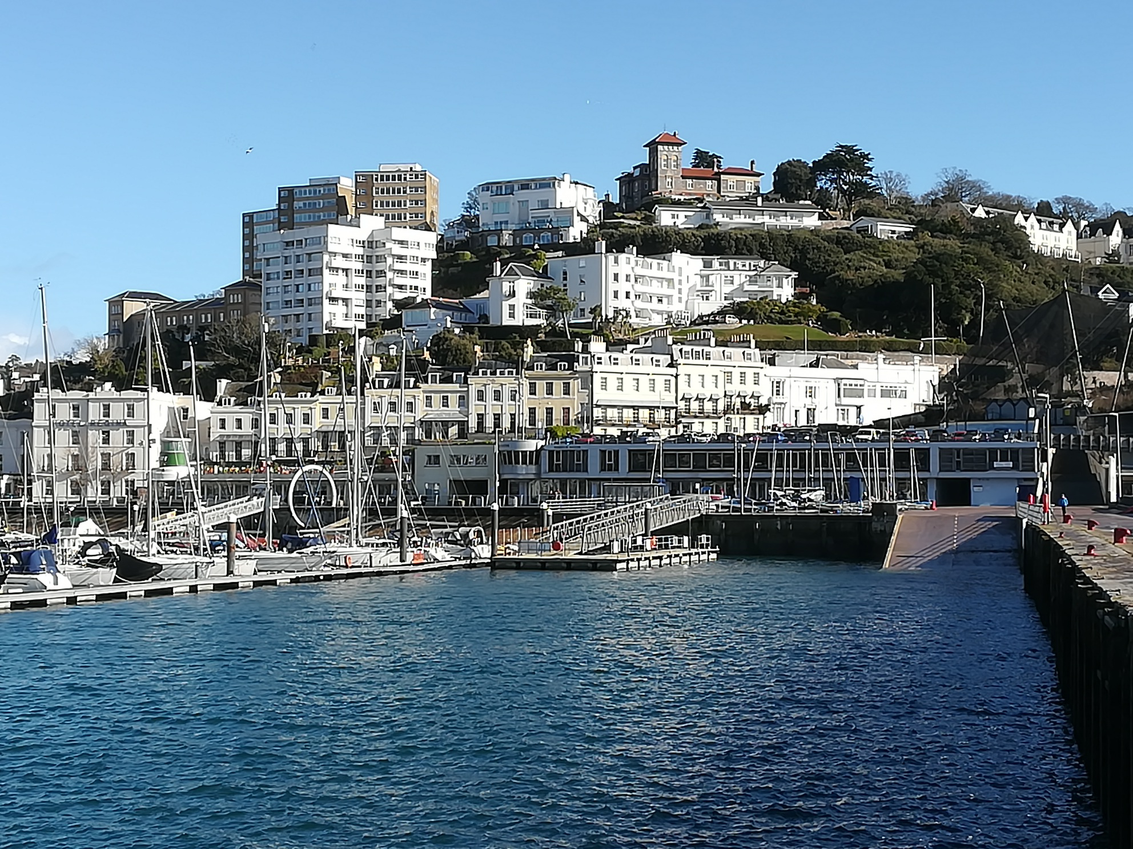
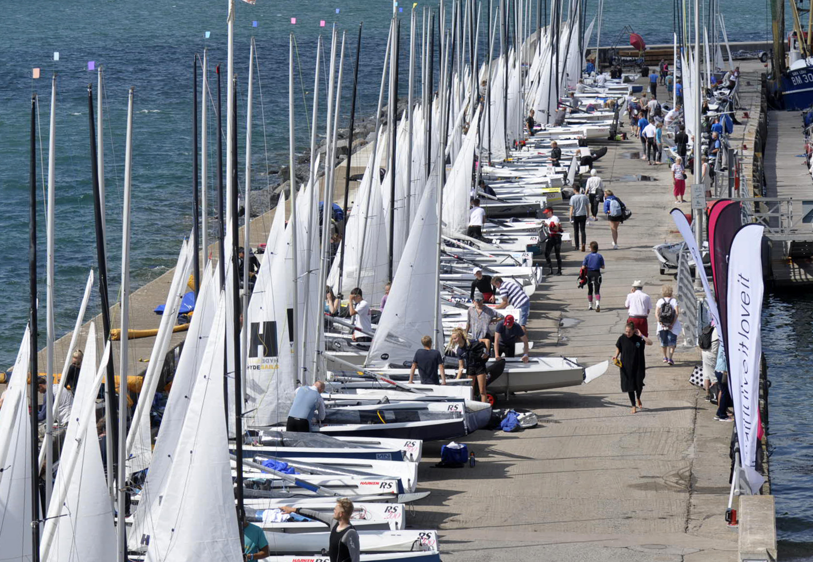
Logistics and Facilities
Accommodation
Numerous accommodation options via usual websites
30 campervan spaces within walking distance
Discount options via the event website
Regatta support
Onsite P&B chandlery van
Sail maker
Boat repairs
In the works
Ferry deals
Boat charter
Coaching
Youth discounts
NOR available late 2025/early 2026
Delivery of a new Windermark boat (see Dave Hall)
  Australia
  Europe

Slide 8
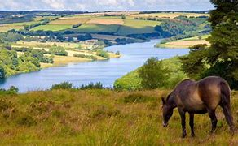
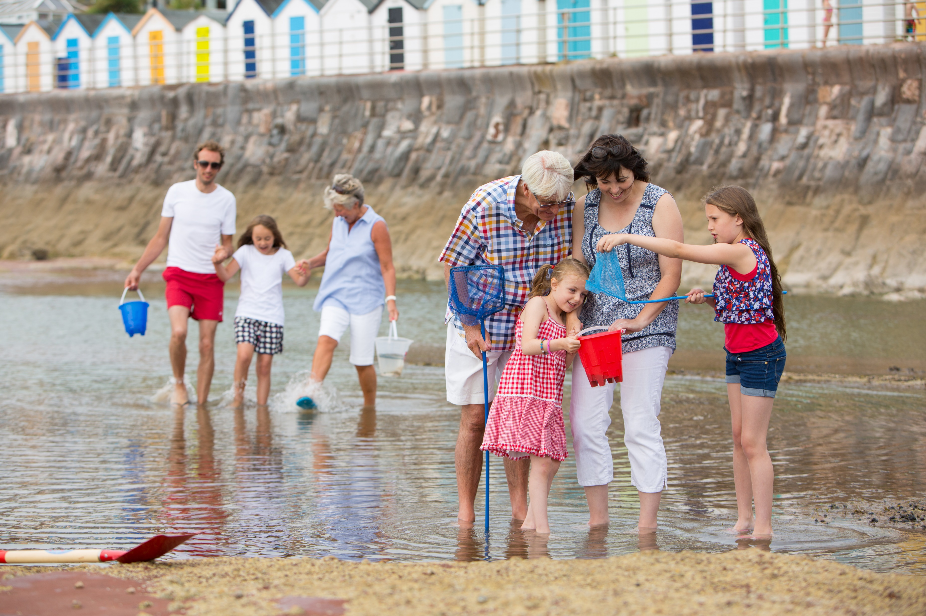
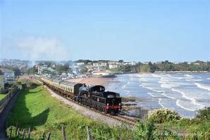
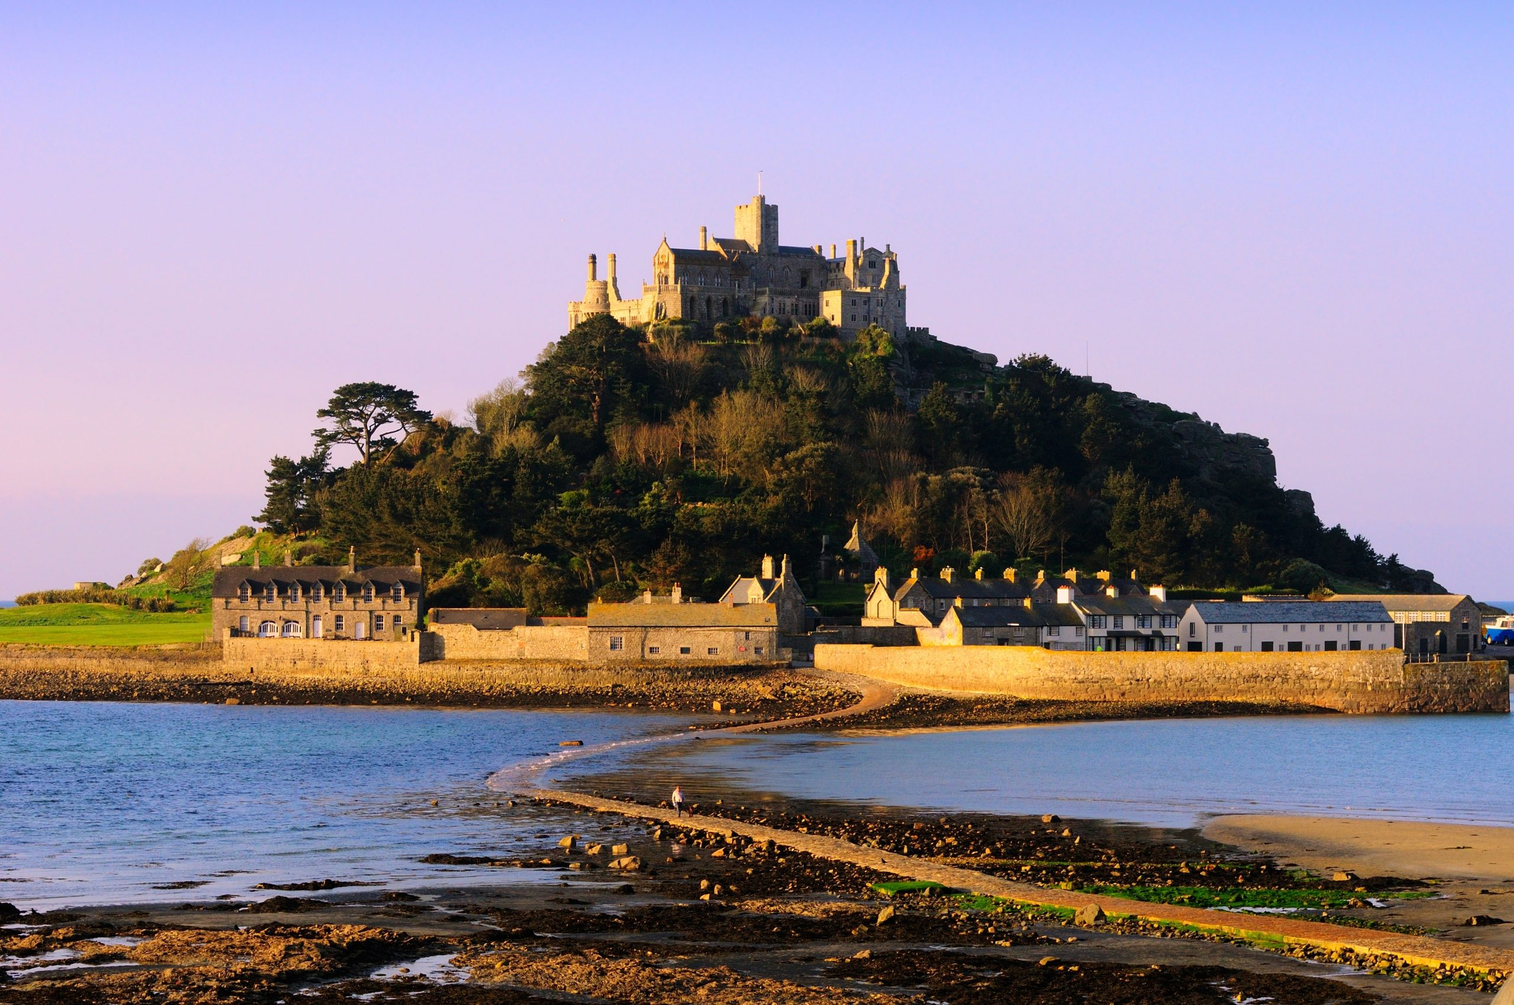
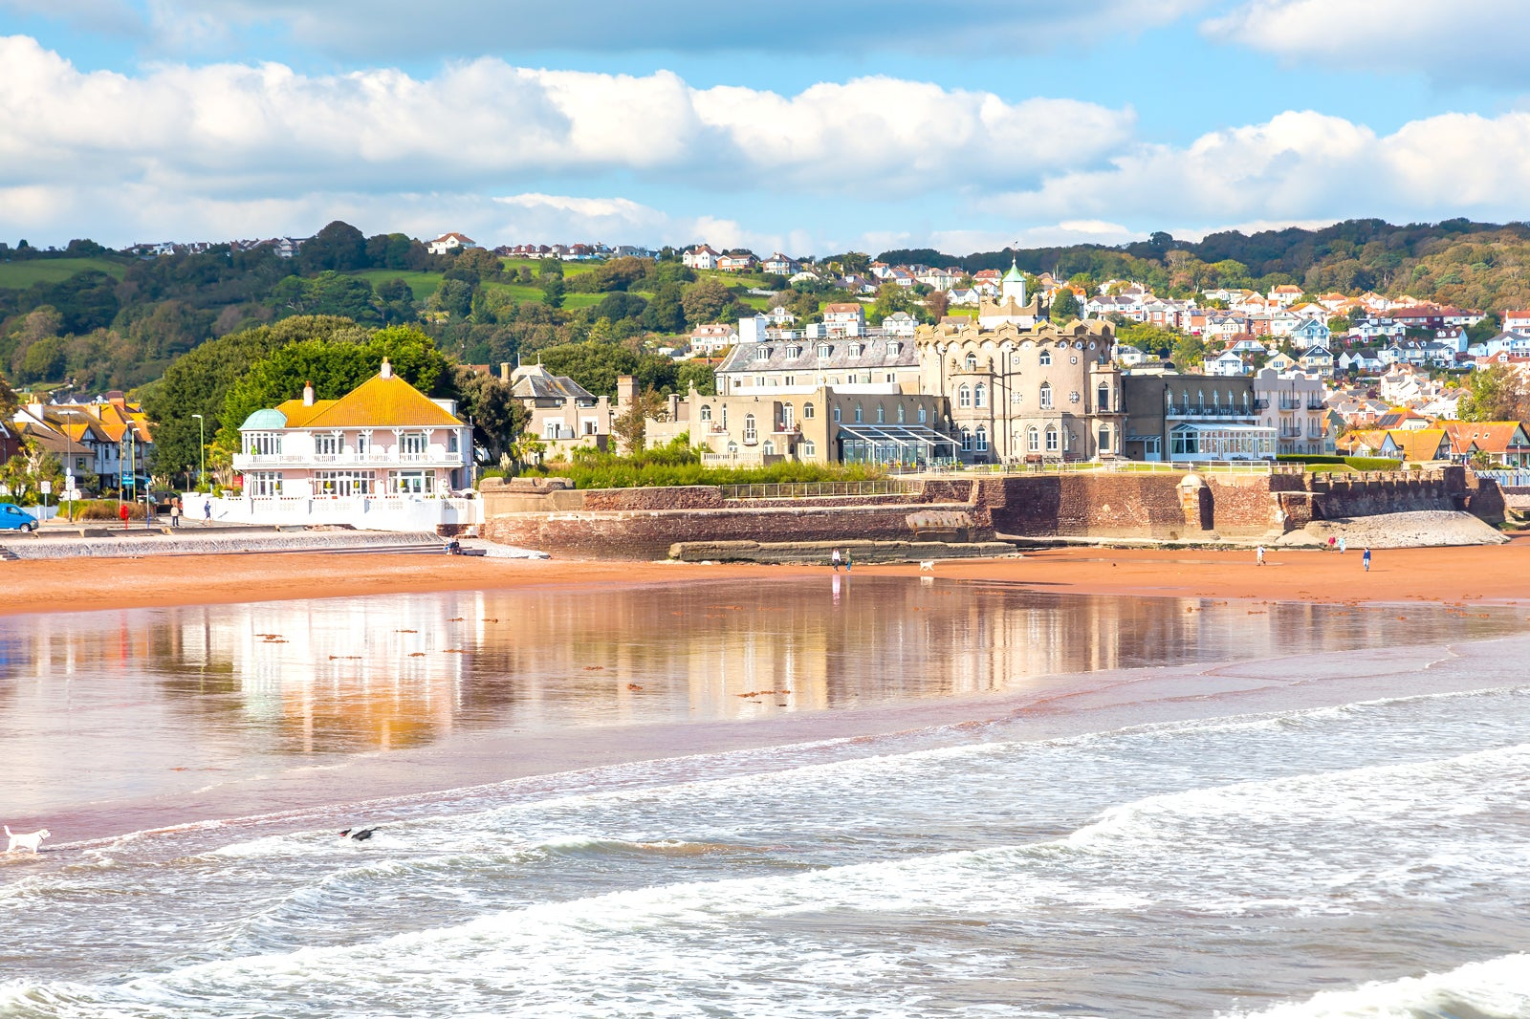
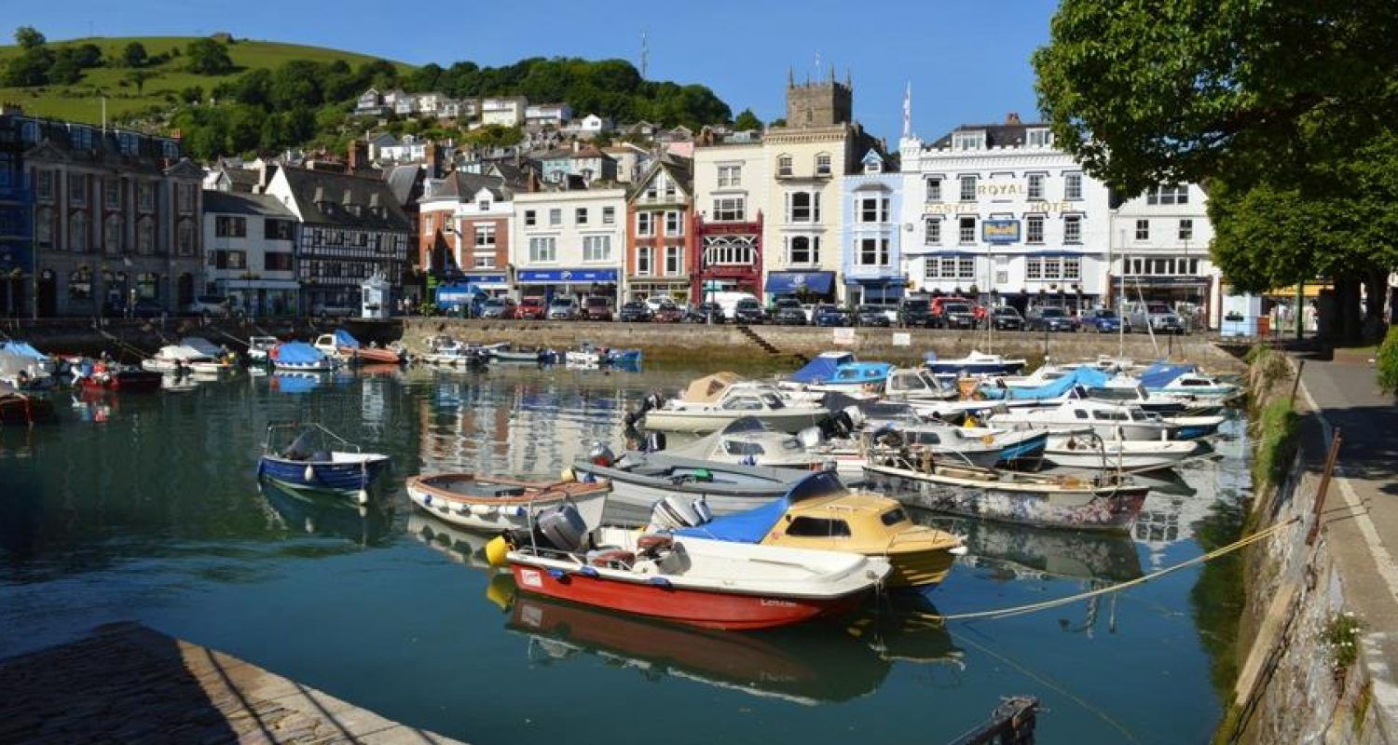
Torquay – A holiday destination
Torbay
Local beaches
Boat trips
Steam train to Dartmouth
Exmoor National Park
Paignton Zoo
Brixham Harbour
Further afield (but within 3 hours)
Cornwall and stunning beaches
Bristol and Exeter historical cities
St Michaels Mount and Land’s End

Slide 9
Questions?/Fragen?/Otázky?/Domande?
This presentation and further info can be found at: fireballworlds2026.attorbay.com
Or email: events@rtyc.org

Slide 10
Expression of Interest
Sign up now and get yourself in a draw for a free entry or new jib
Rules
£50 to be paid by 31/10/2025
Draw will be made on 01/11/2025
£50 is non-refundable but will be deducted from your entry fee
Full entry needs to be made before Early Bird entry cut-off
And the prizes……
First non-UK boat: free entry to the UK Nationals and Worlds
First UK boat: free P&B jib
Apply via the QR code

