Slide 1
Fireball World Championship 2018
August 22nd –August 31st

Slide 2
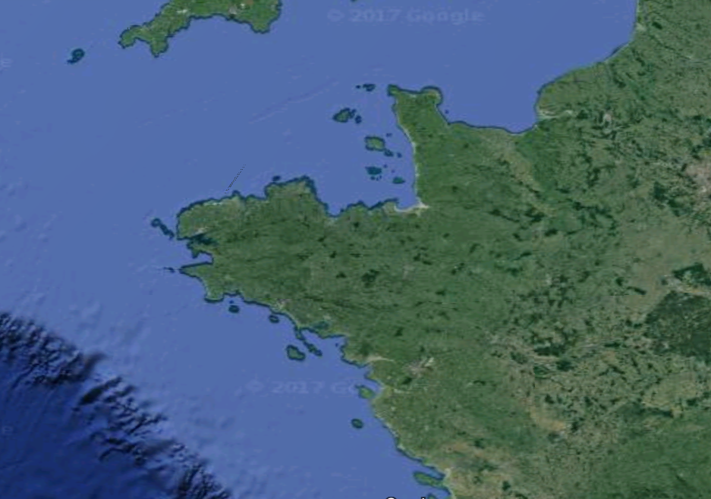
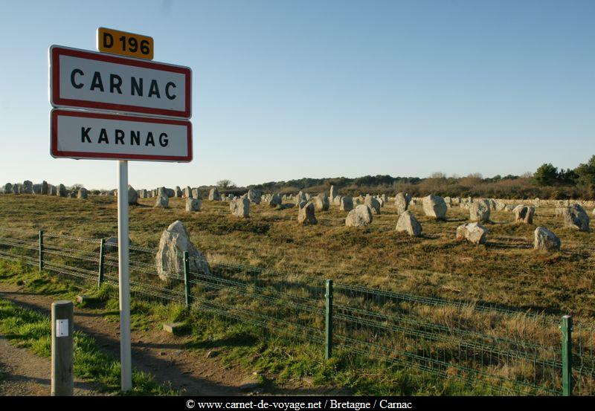
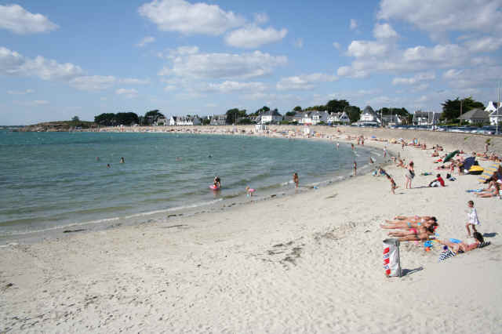
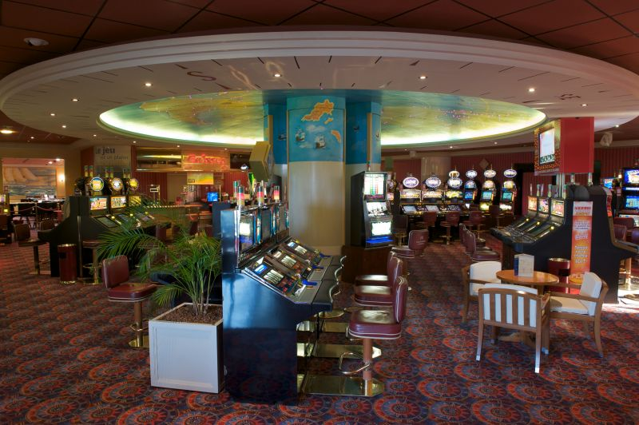
The Venue
Carnac is a picturesque city in South Britany, well known for standing stones but as well a great place to sail and enjoy vacations

Slide 3
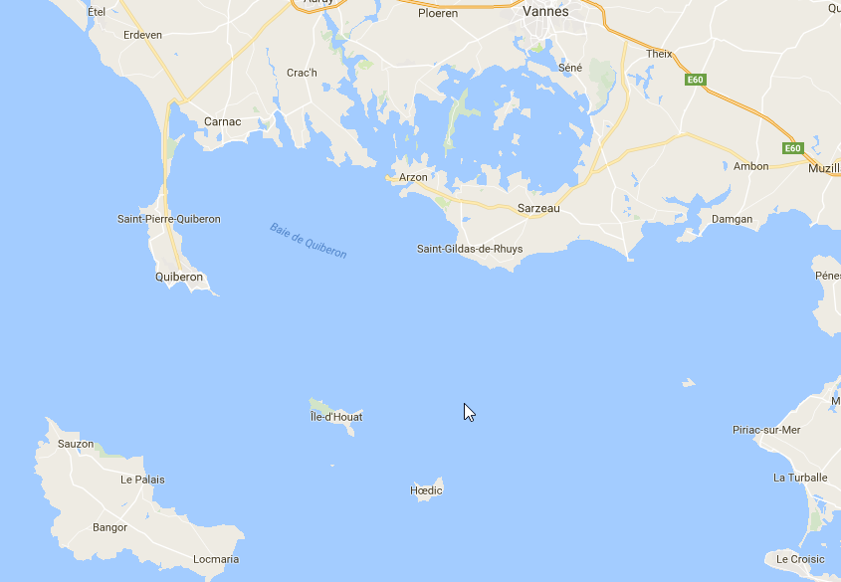
The Venue
Sailing area in the bay of Quiberon
is protected from Atlantic swell

Slide 4
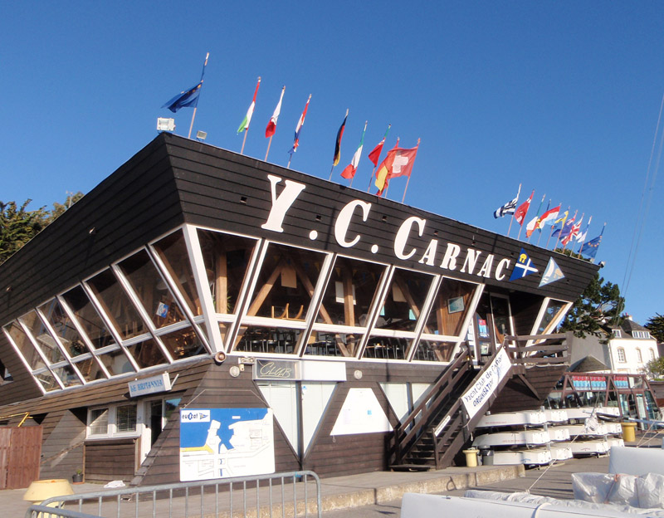
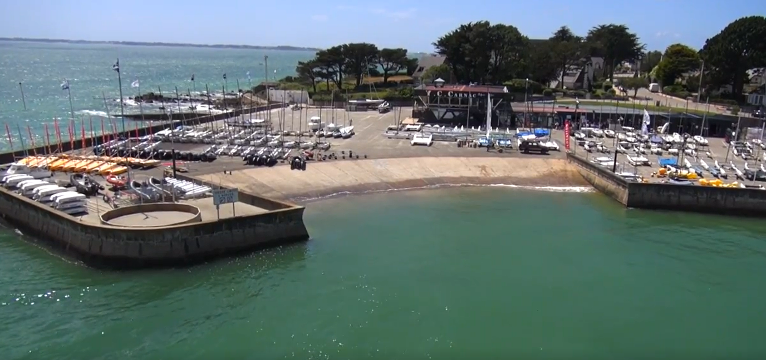
The Club
Large dinghy park, dedicated ramp, convenient club house.

Slide 5
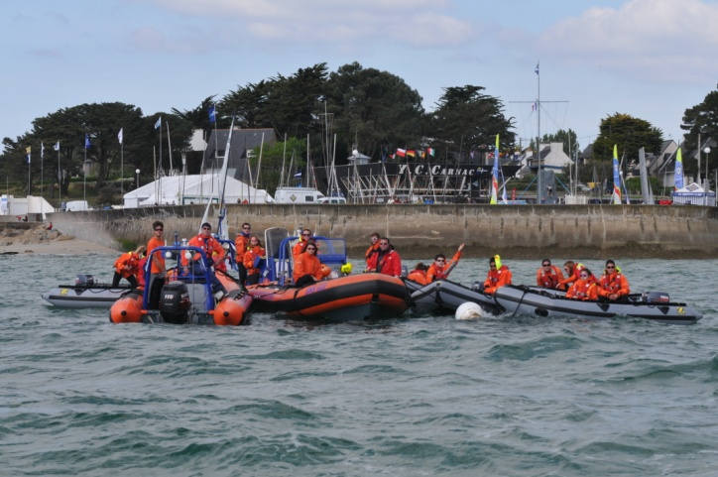
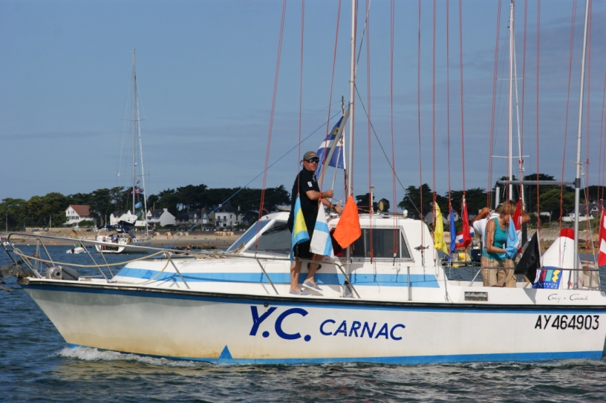
The Team
A team of professionals and volunteers used to organize international events.

Slide 6
Pasts events
International events
2015 European RS
Tornado world championship
2016 Musto Skiff world championship
I14 world championship
2017 RS Aero world championship
RS Tera world championship
And many others
31st Eurocat (2nd European cat event)
2nd European Dinghies
and several French Nationals

Slide 7
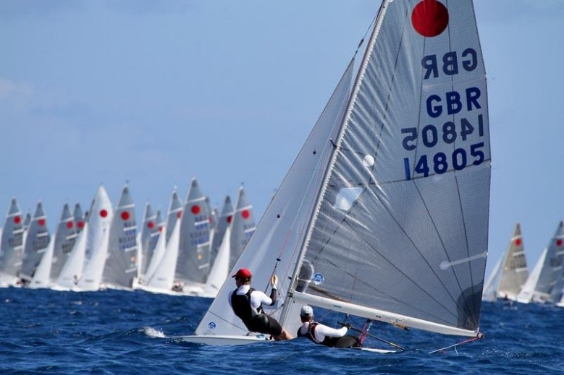
The Program
Wed August 22nd Registration and measurement
Thu August 23th French National and Preworlds
Fri August 24th French National and Preworlds
Sat August 25th Registration and measurement
Sun August 26th Worlds, 2 Races
Mon August 27th Worlds, 2 Races
Tue August 28th Worlds, 2 Races
Wed August 29th Lay day
Thu August 30th Worlds, 2 Races
Fri August 31st Worlds, 2 Races

Slide 8
The Social Program
Sun August 26th : Opening Ceremony
Tue August 28th : Crews Dinner
Thu August 30th: Dinner BBQ Next Worlds Promotion
Fri August 31st Prize giving and closing ceremony
On race days: Prices giving and post races drinks

Slide 9
Useful Links
www.ot-carnac.fr
www.morbihan.com/accueil/decouvrir/le-morbihan/les-principales-destinations/carnac
www.yccarnac.com
www.facebook.com/YachtClubCarnac
www.fireball-france.org

